Slide 1

Enrollment Transfer
Click to Begin

Slide 2
Error!
Please follow the on-screen
instructions to continue.
Go Back

Slide 3
Complete
Please navigate to the next module
in the course to continue.
Restart Course

Slide 4
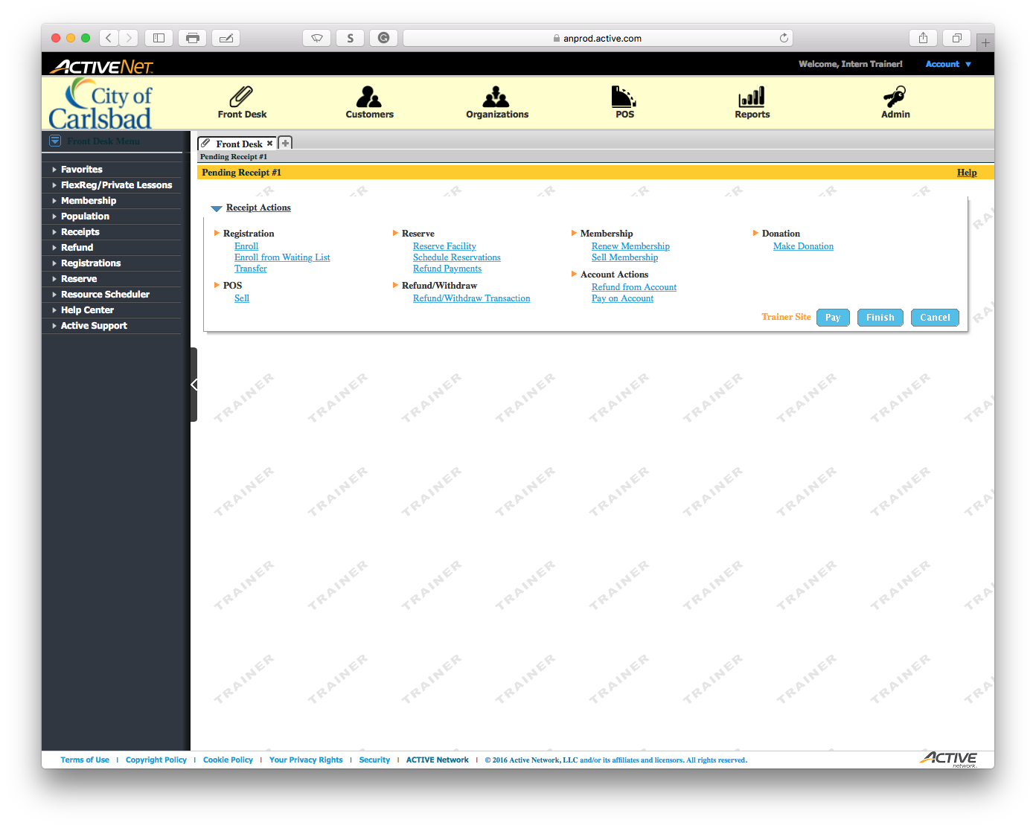
Tip:
Main Text Instruction Will Go Here
Select Transfer
Sub Instruction Here
In order to transfer a client, they must be currently enrolled in a program.

Slide 5
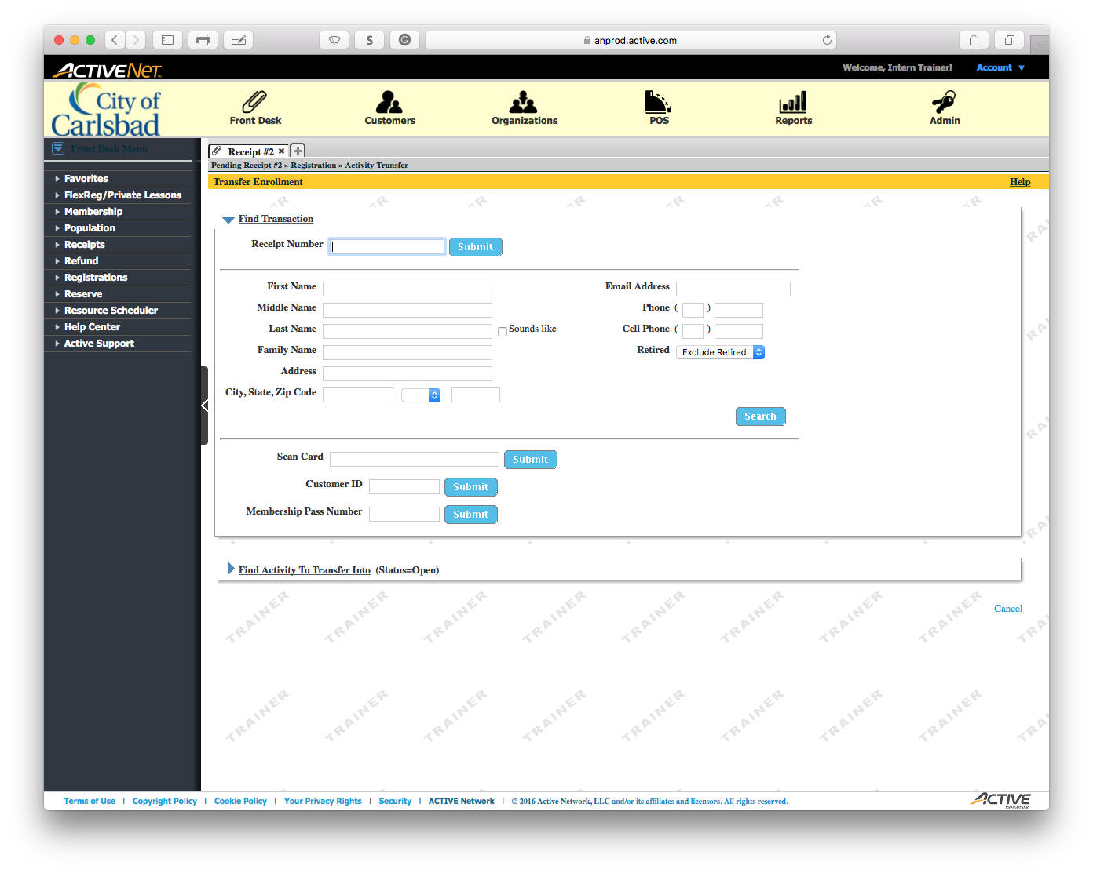
Tip:
Main Text Instruction Will Go Here
Input the First Name
Sub Instruction Here

Slide 6
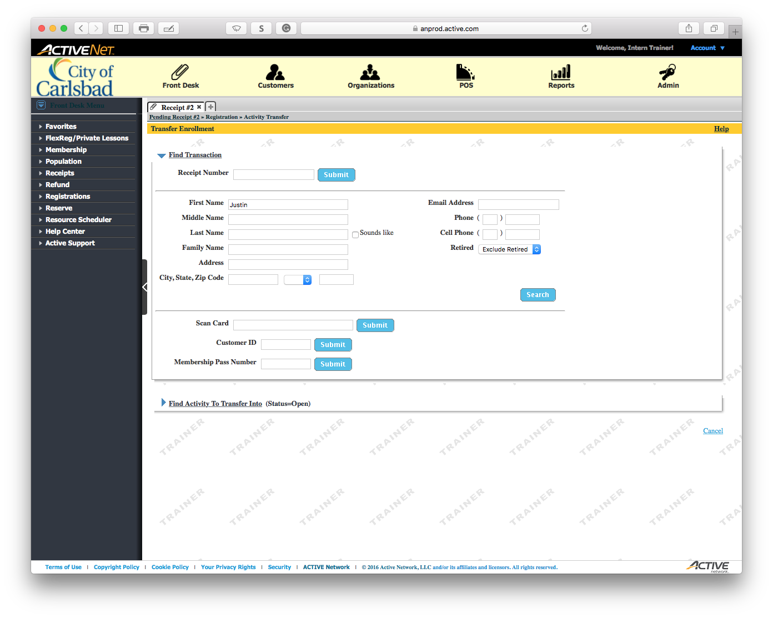
Tip:
Main Text Instruction Will Go Here
Input the Last Name
Sub Instruction Here

Slide 7
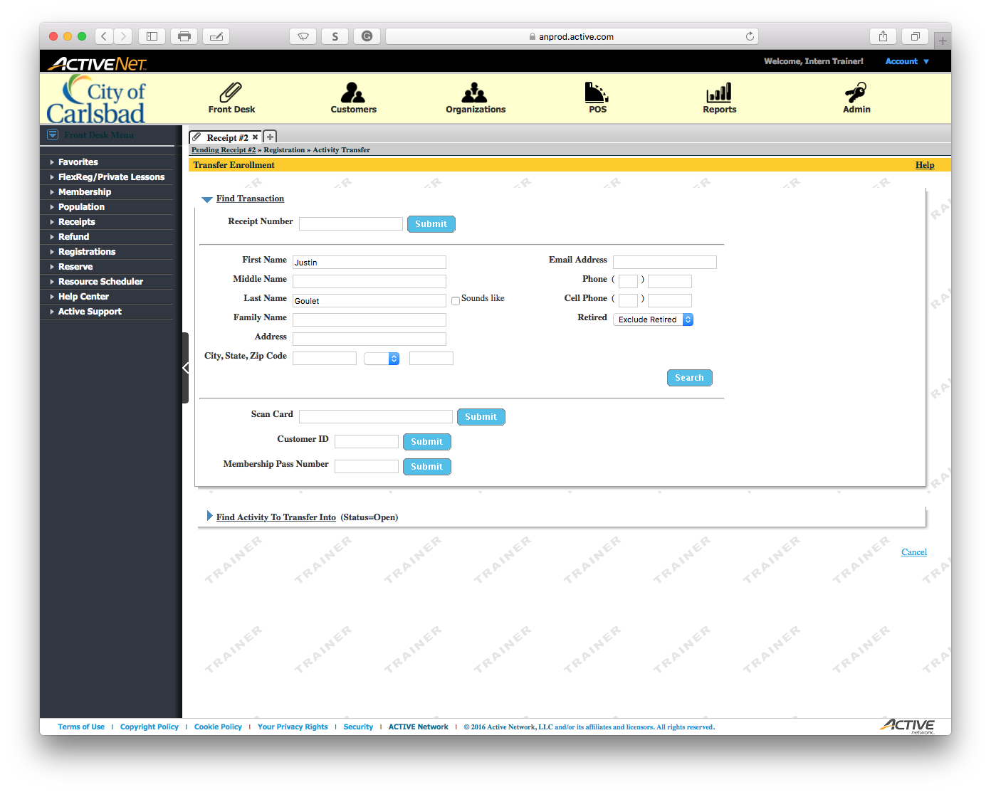
Tip:
Main Text Instruction Will Go Here
Search for the patron
Sub Instruction Here

Slide 8
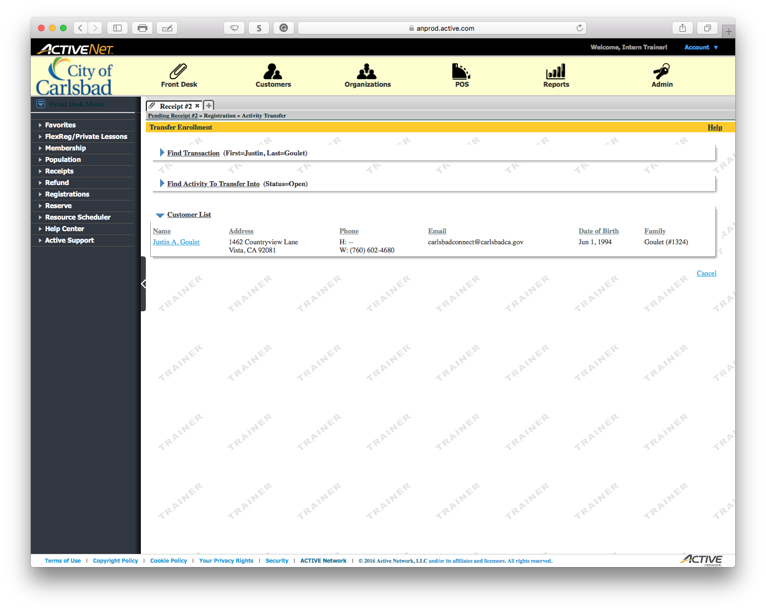
Tip:
Main Text Instruction Will Go Here
Select the patron from the list.
Sub Instruction Here
If there are multiple accounts, have the client verify a distinguishing factor.

Slide 9
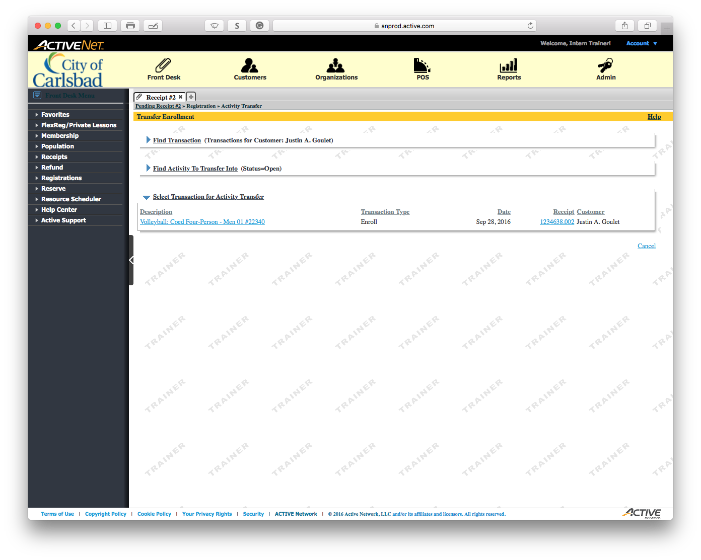
Tip:
Main Text Instruction Will Go Here
Select the course the clients wishes to withdraw from.
Sub Instruction Here
You may also see the original receipt.

Slide 10
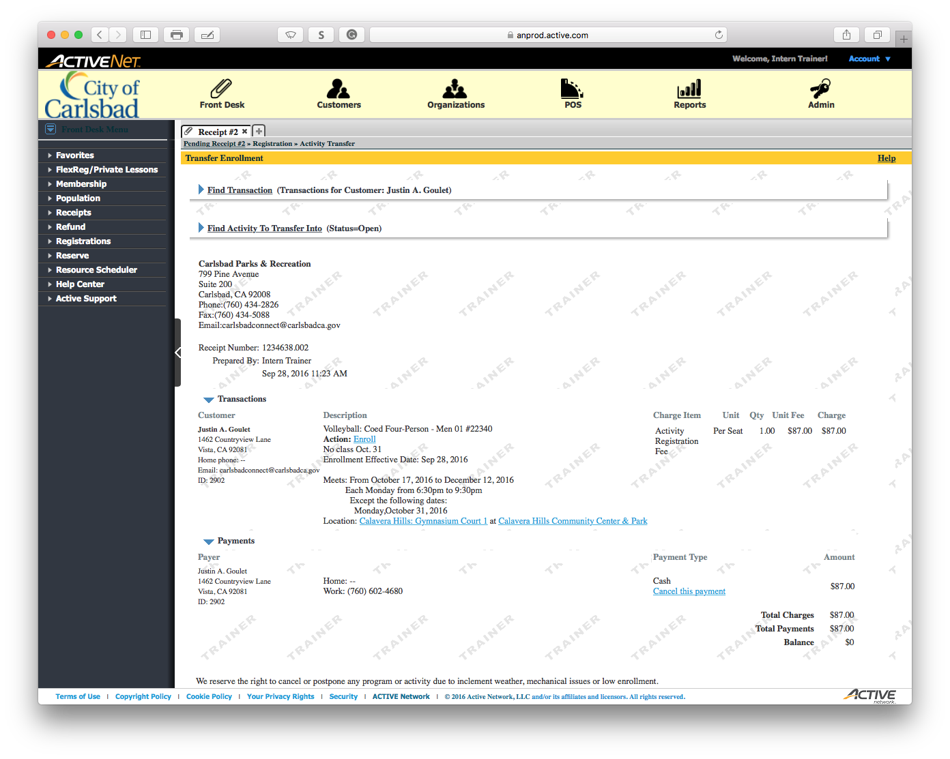
Tip:
Main Text Instruction Will Go Here
Collapse the receipt to continue
Sub Instruction Here

Slide 11
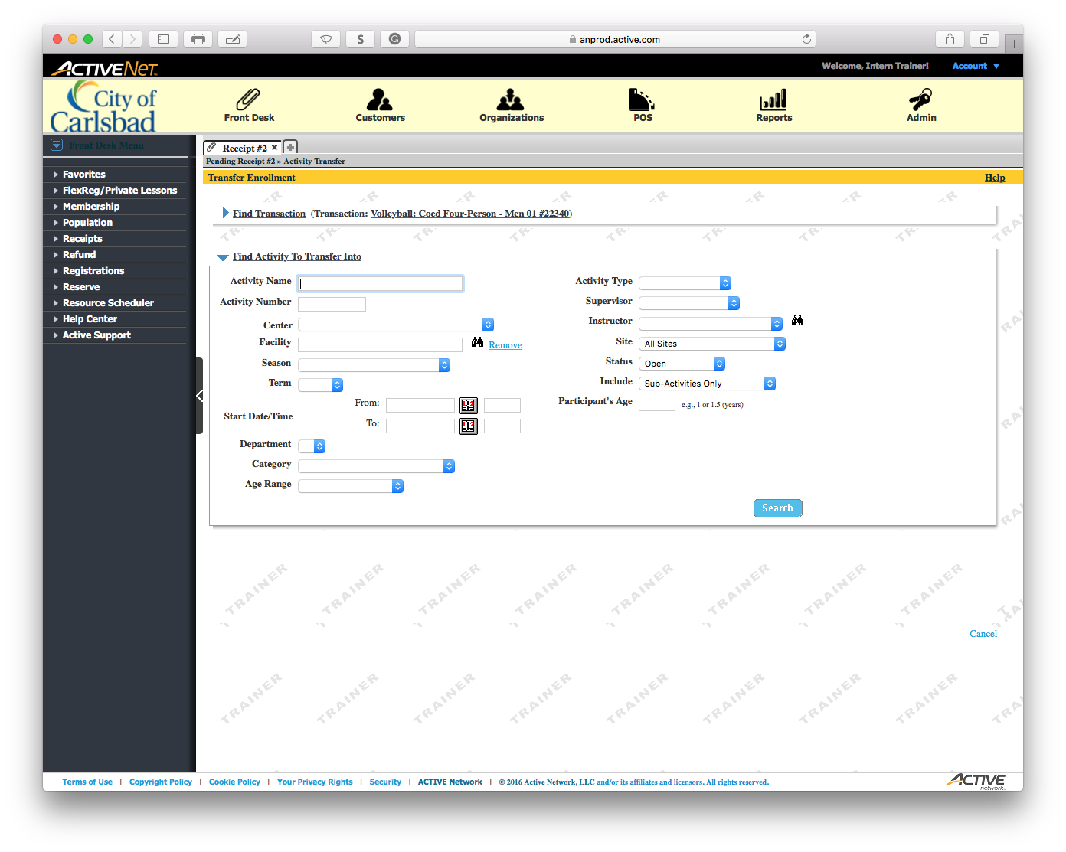
Tip:
Main Text Instruction Will Go Here
Search for an activity to enroll
Sub Instruction Here

Slide 12

Tip:
Main Text Instruction Will Go Here
Click to search
Sub Instruction Here

Slide 13
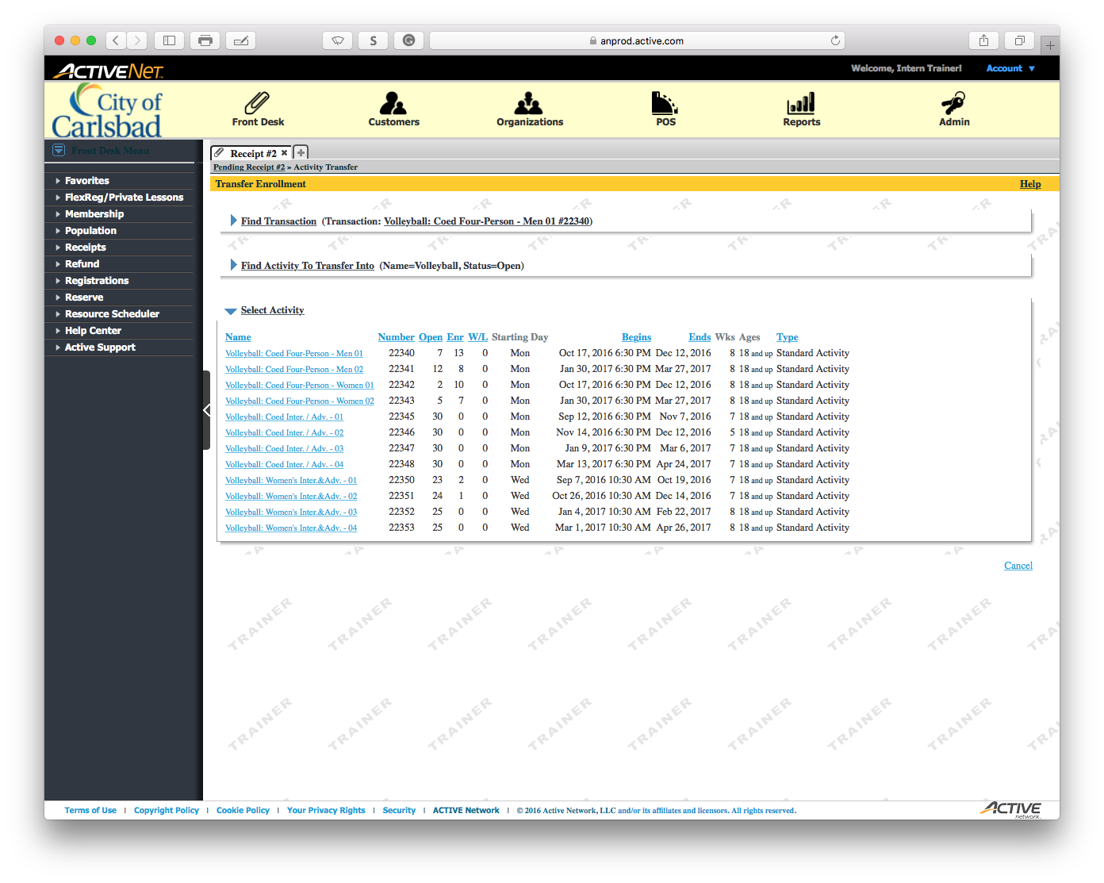
Tip:
Main Text Instruction Will Go Here
Select the course in which to enroll
Sub Instruction Here
In this case, select Volleyball: Coed Four-Person – Men 02

Slide 14
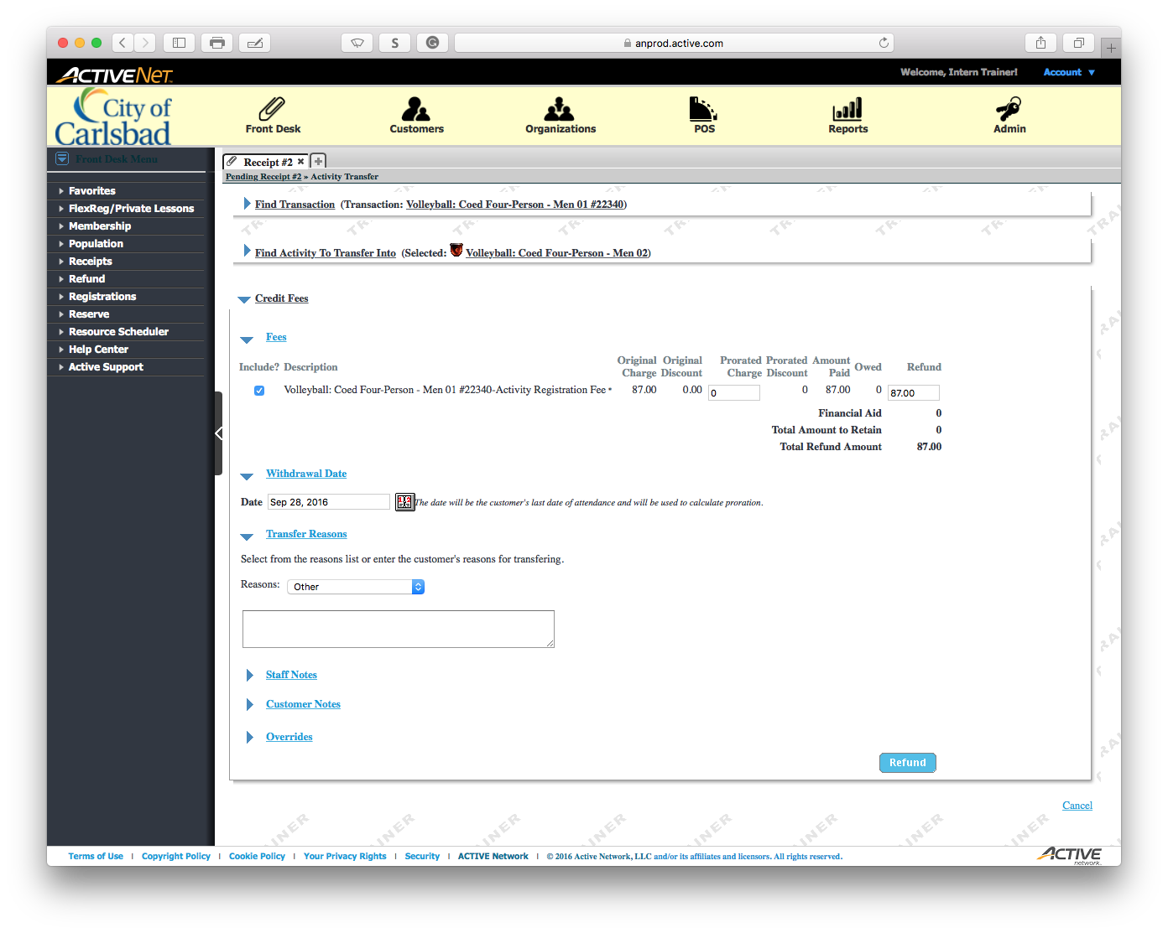
Tip:
Main Text Instruction Will Go Here
Select a reason for transfer
Sub Instruction Here

Slide 15
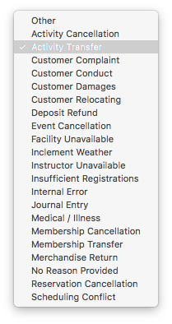
Tip:
Main Text Instruction Will Go Here
Select the appropriate option
Sub Instruction Here
In our case, we are just doing an activity transfer.

Slide 16
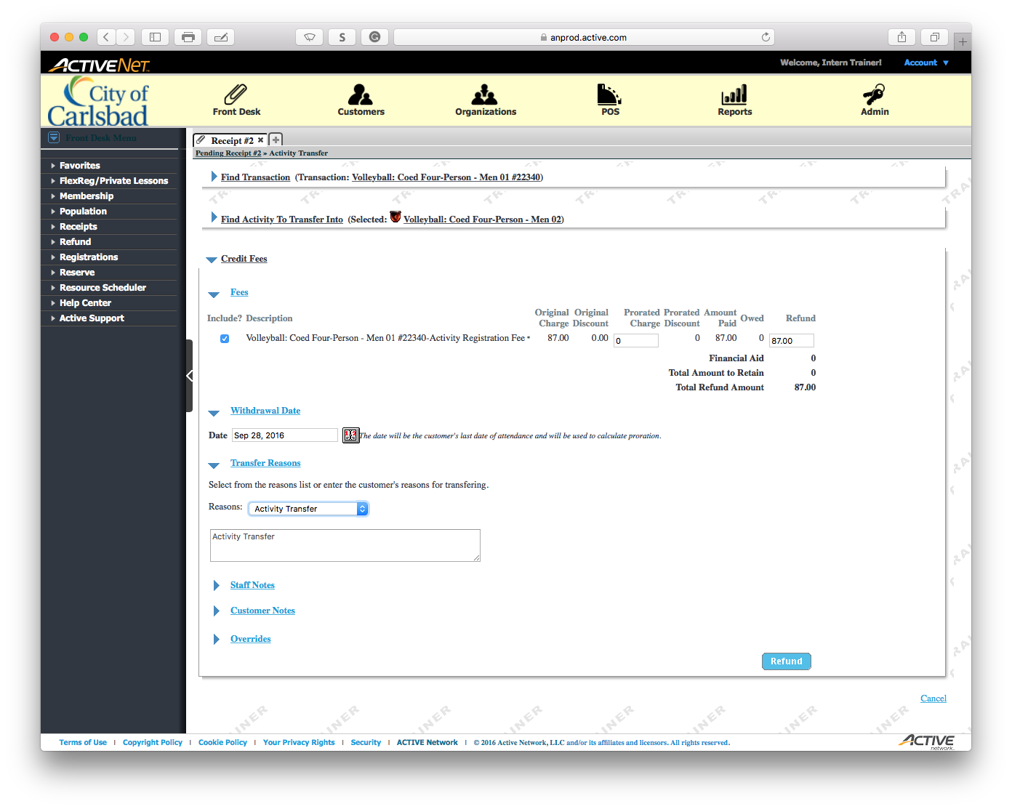
Tip:
Main Text Instruction Will Go Here
Collapse the Transfer Reasons section.
Sub Instruction Here

Slide 17
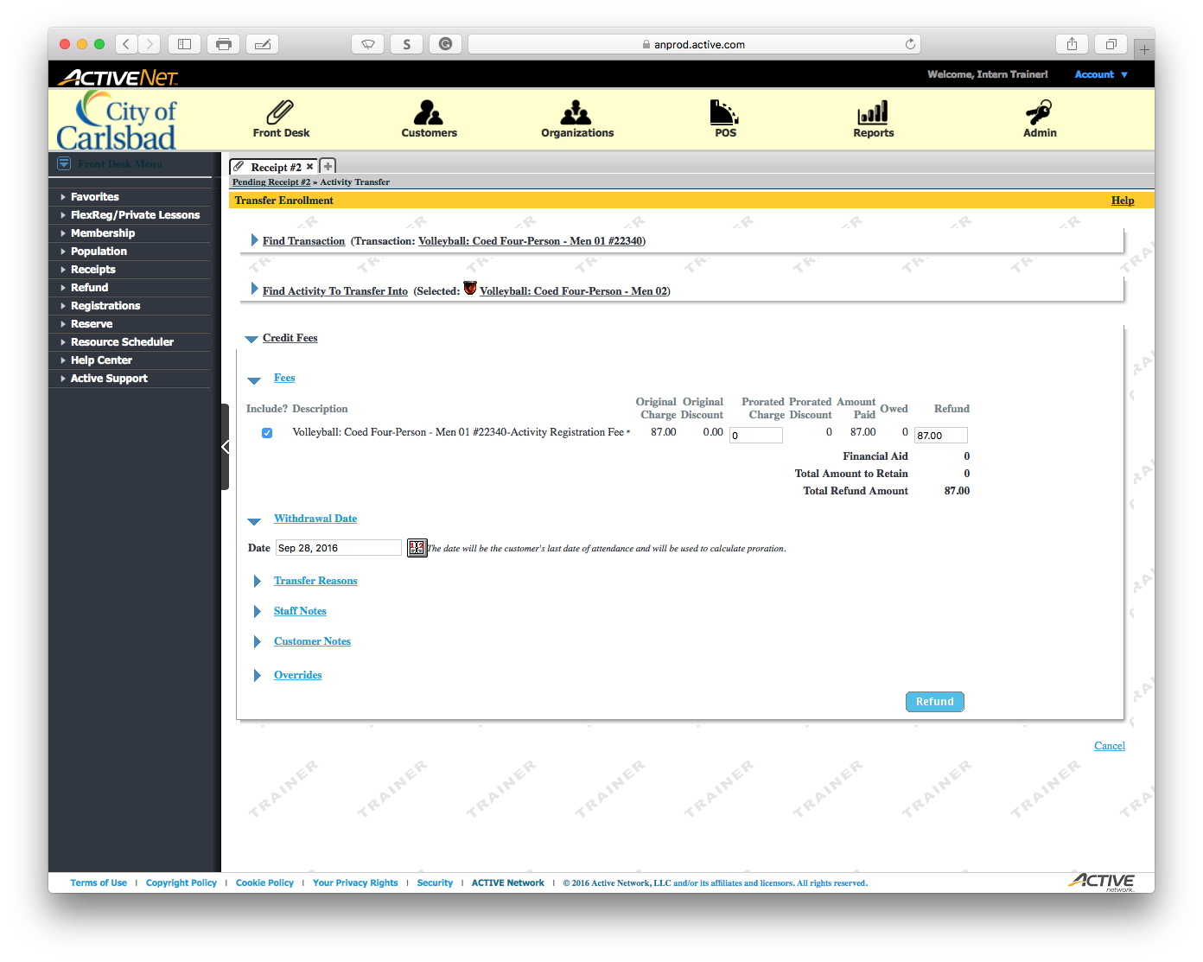
Tip:
Main Text Instruction Will Go Here
Refund the full amount to apply to transfer
Sub Instruction Here

Slide 18
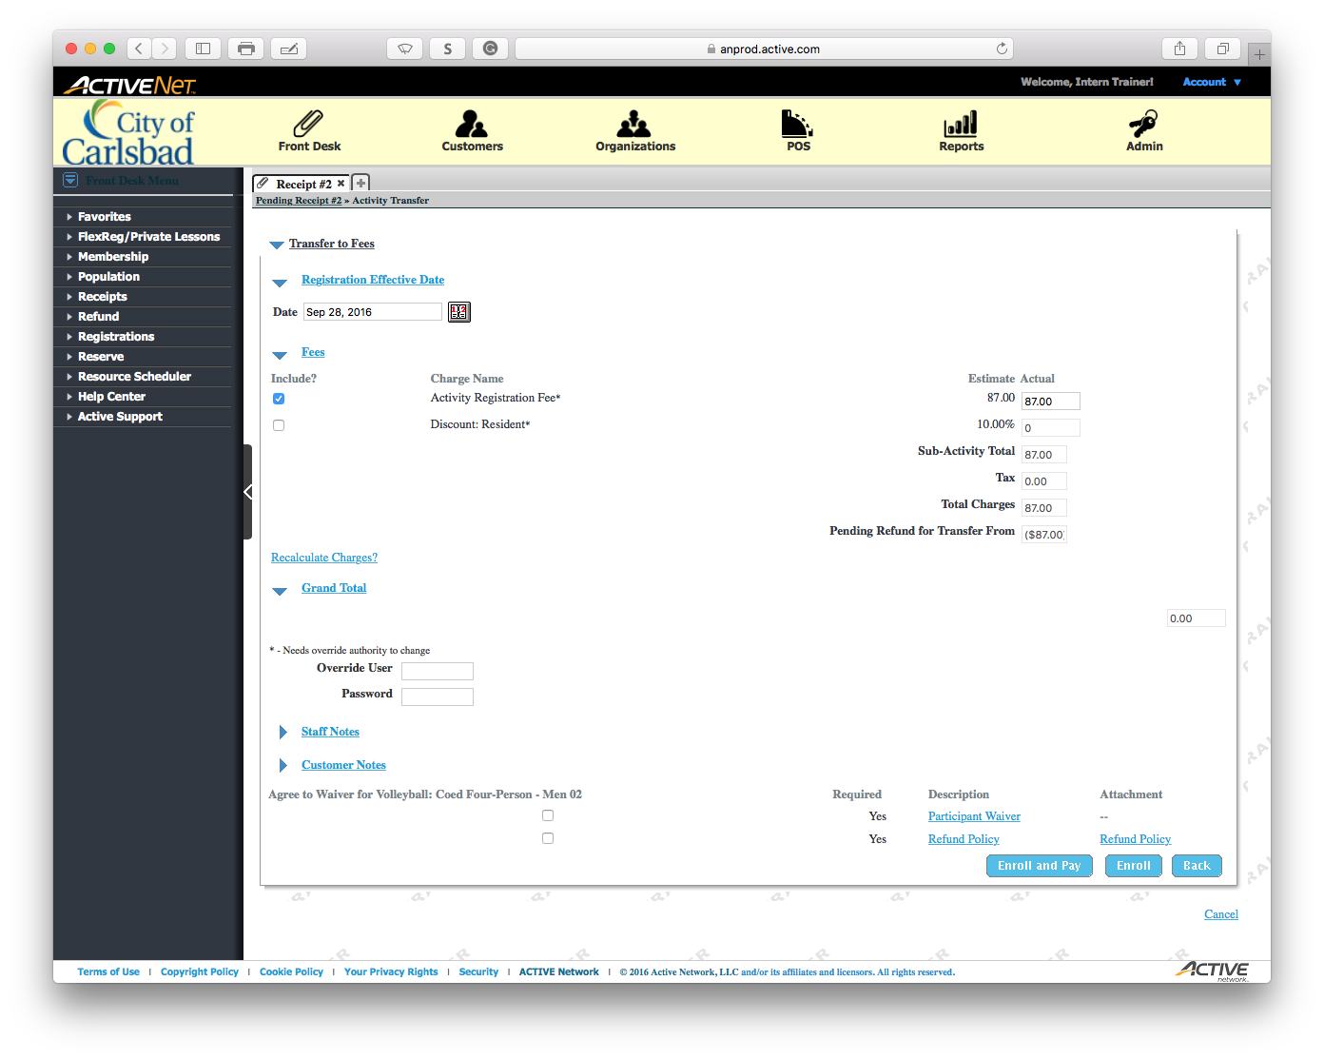
Tip:
Main Text Instruction Will Go Here
Ensure the client agrees to the waiver
Sub Instruction Here
The waiver contains Photographic and Release of Liability releases.

Slide 19

Tip:
Main Text Instruction Will Go Here
Ensure the client agrees to the Refund Policy
Sub Instruction Here

Slide 20

Tip:
Main Text Instruction Will Go Here
Enroll and Pay
Sub Instruction Here

Slide 21

Tip:
Main Text Instruction Will Go Here
Select the Customer as the Payer
Sub Instruction Here

Slide 22
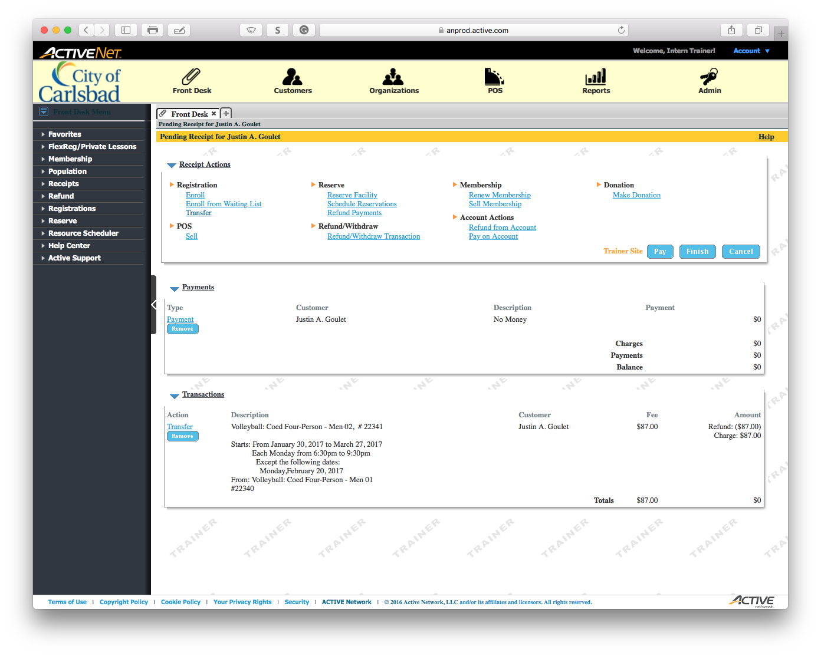
Tip:
Main Text Instruction Will Go Here
Finish the transaction
Sub Instruction Here
Notice that since the balance and the refund were equal, this is a non-monetary receipt.

Slide 23
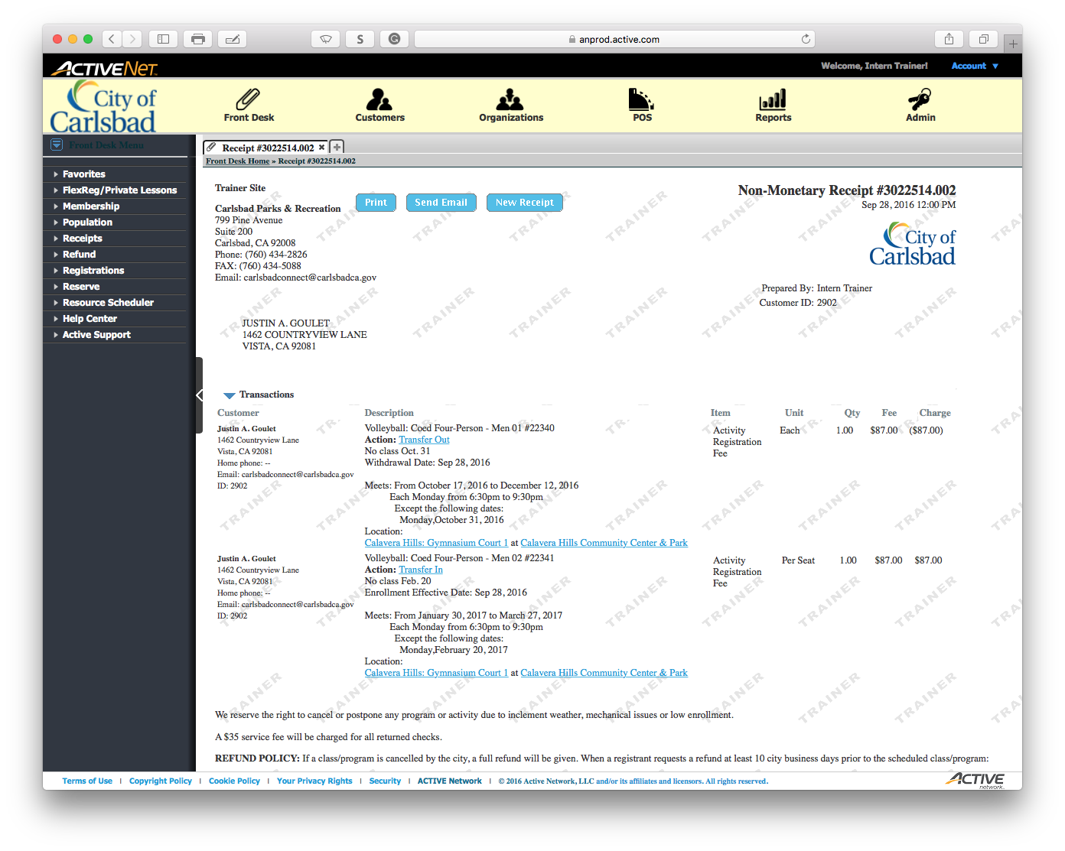
Tip:
Main Text Instruction Will Go Here
Send the client the receipt via email
Sub Instruction Here

Slide 24
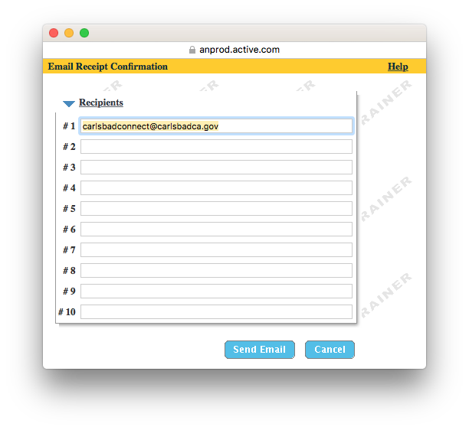
Tip:
Main Text Instruction Will Go Here
Confirm the email and send
Sub Instruction Here

